Slide 1

AUTOMATED
STREETLIGHT
CONTROL SYSTEM
Mini Project Presentation
2620040081 Mohith
2620040083 Santhosh
2620040157 Jaideep
2620040178 Anudeepika
2620040179 Srivani
Department of ECE
College: KLH University
Academic Year: 2026–27

Slide 2

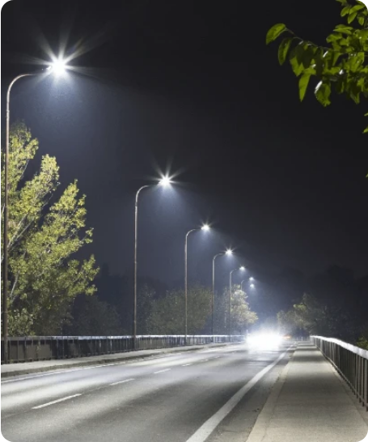
PROBLEM STATEMENT & OBJECTIVE
Why Automate Street Lighting?
1. Energy Waste
Fixed-schedule or manual lamps burn at full power in daylight and on empty roads.
2. Safety Need
Roads must be bright when a person or vehicle is present.
3. Our Goal
Lamp ON only when dark, bright only when needed, with a manual override.
System Output Rule
3 Inputs → 2 Signals → 3 States (OFF · DIM · BRIGHT)

Slide 3
LOGIC ARCHITECTURE SELECTION
Why Combinational Logic is Enough
Feature | Combinational Logic | Sequential Logic
Output depends on | Present inputs only | Present inputs + past state
Memory / clock | None | Flip-flops + clock
Speed | Gate-delay fast | Clock-edge paced
Street light rule | Lamp = f(dark, motion, override) | Not needed for the base rule
Deterministic Memoryless Mapping
The rule never needs to remember anything: the same three sensor readings always yield the exact same lamp state. (Comparison drawn from Module 3 sequential-logic slides)

Slide 4
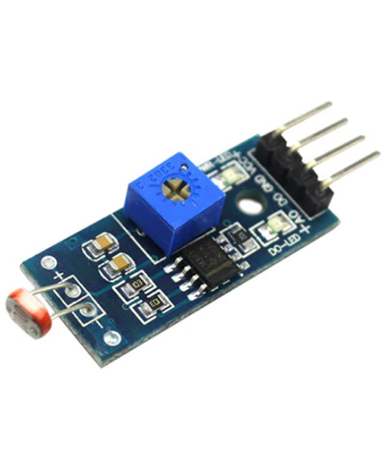

BLOCK DIAGRAM OVERVIEW
System Architecture
Sensors
LDR (light) • PIR (motion) • Override switch
Conditioning
Comparator / Schmitt trigger → Clean 0/1 logic levels
Combinational Logic
AND • OR • NOT gates (Focus Block)
Driver
Transistor / PWM level selector circuit
LED Lamp
3 Physical States: OFF • DIM • BRIGHT
* Note: Only the highlighted logic block is designed and simulated in this study; interface modules handle digital conversion.

Slide 5
SYSTEM I/O DEFINITION
Signals and Design Specification
Signal Dictionary
Operating Logic Rules
Signal | Direction | Meaning when active (= 1)
D |  | Dark (LDR sensor below threshold)
M |  | Motion / vehicle detected by PIR
O |  | Manual override switch ON
BRIGHT |  | Lamp at full power brightness
DIM |  | Lamp at low, energy-saving level
Daylight, no override
→ OFF
Input
Input
Dark, no motion
→ DIM
Input
Dark + motion detected
→ BRIGHT
Output
Output
Override switch ON
→ BRIGHT always

Slide 6
EXHAUSTIVE STATE MAPPING
System Truth Table
D | M | O | BRIGHT | DIM | State
0 | 0 | 0 | 0 | 0 | OFF
0 | 0 | 1 | 1 | 0 | BRIGHT
0 | 1 | 0 | 0 | 0 | OFF
0 | 1 | 1 | 1 | 0 | BRIGHT
1 | 0 | 0 | 0 | 1 | DIM
1 | 0 | 1 | 1 | 0 | BRIGHT
1 | 1 | 0 | 1 | 0 | BRIGHT
1 | 1 | 1 | 1 | 0 | BRIGHT
Key Observations
•
BRIGHT and DIM are never 1 together, ensuring mutual exclusion.
•
Two binary output bits are sufficient to represent all 3 physical states.
•
In daylight (D=0), the lamp remains OFF unless manual override (O=1) is pressed.
Verified against all 8 input combinations during formal simulation.

Slide 7
BOOLEAN MINIMIZATION
K-Map Simplification
BRIGHT Output Equation
BRIGHT = O + D·M
DIM Output Equation
DIM = D·M′·O′
DM \ O | O = 0 | O = 1
00 | 0 | 1
01 | 0 | 1
11 | 1 | 1
10 | 0 | 1
DM \ O | O = 0 | O = 1
00 | 0 | 0
01 | 0 | 0
11 | 0 | 0
10 | 1 | 0
Grouping: Column O=1 gives term O; Row DM=11 gives term D·M.
Single Minterm: Active only when dark (D=1), no motion (M=0), no override (O=0).

Slide 8

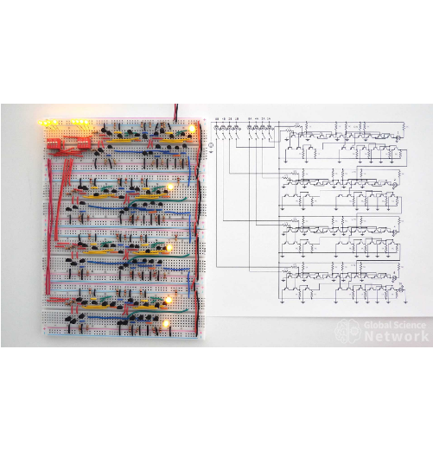
LOGIC IMPLEMENTATION
Gate-Level Circuit Design
MINIMISED BOOLEAN EXPRESSIONS
BRIGHT = O + D · M
DIM = D · M′ · O′
Gate Inventory Required
1x 2-input OR gate
1x 2-input AND gate
1x 3-input AND gate
2x NOT gates (Inverters)
* OFF State condition is implicitly satisfied when both BRIGHT and DIM equal 0 (OFF = D′ · O′).

Slide 9

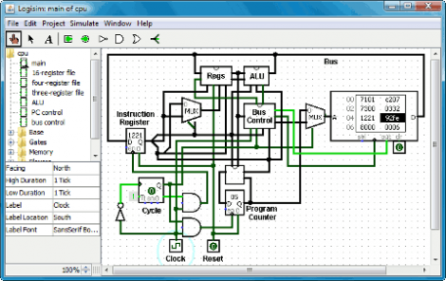
VIRTUAL PROTOTYPING
Simulation Procedure in Logisim
1
Add Input Pins
Place three input pins labeled D, M, and O (use poke tool to toggle logic levels).
2
Wire Logic Gates
Connect AND, OR, two NOT, and one 3-input AND gate from Gates library.
3
Attach Output Indicators
Connect two LED probes labeled BRIGHT and DIM.
4
Test & Analyze
Poke all 8 combinations & execute Project > Analyze Circuit to confirm exact match.

Slide 10
TIMELINE TEST EXECUTION
Simulated Day-Night Scenario
Time Segment / Event | D (Dark) | M (Motion) | O (Override) | BRIGHT | DIM | System State
Daytime (Passer-by passes) | 0 | 1 | 0 | 0 | 0
Dusk / Night begins (No motion) | 1 | 0 | 0 | 0 | 1
Vehicle arrives at night | 1 | 1 | 0 | 1 | 0
Vehicle departs | 1 | 0 | 0 | 0 | 1
Manual override switch flipped | 0 / 1 | 0 / 1 | 1 | 1 | 0
Dawn / Sunlight returns | 0 | 0 | 0 | 0 | 0
OFF
DIM
BRIGHT
DIM
BRIGHT
OFF
Verification Result: Time steps 0 → 11 transition flawlessly without state race conditions or forbidden output overlap.

Slide 11


SCOPE & REAL-WORLD USE
Extensions and Applications
Sequential Extension (Hold Timer)
Add a counter + D flip-flop to keep the lamp BRIGHT for N clock cycles after motion stops. (Integrates Module 3 sequential logic concepts).
Practical Deployment Fields
Campus roads, municipal parking lots, express highways, tunnels, and smart residential lanes.
System Limitations
Pure gates react instantaneously: flickering sensor noise causes light flicker; missing fault detection.

Slide 12
SUMMARY & BIBLIOGRAPHY
Conclusion & Key References
Project Takeaways
Academic References
A 3-input, 2-output gate network successfully delivers accurate OFF, DIM, and BRIGHT street light control.
Mano & Ciletti
Digital Design, Global Edition, Pearson, 2018.
Floyd, Thomas L.
BRIGHT = O + D·M | DIM = D·M′·O′
Digital Fundamentals, 11th Ed., Pearson India, 2014.
Simulation in Logisim confirms exact correspondence with truth table and day-night scenario requirements.
Questions & Discussion
Department of ECE • 26EC1202E

